Slide 1
Summer Bootcamp in JAVA Lecture 1
Bilal Arif (Senior Lecturer)
Department of Software Engineering, University of Management and Technology Lahore.

Slide 2
Lecture 1 Overview

Slide 3
Introduction to Java Language

Slide 4
History of JAVA
A team at Sun Microsystems, led by James Gosling, initiated the "Green" project to develop a language for consumer electronics like set-top boxes.
Initially called "Oak" after an oak, the name was later changed to "Java" due to trademark conflicts.
Java 1.0 was officially released in 1995, its "write once, run anywhere" (WORA) principle, achieved through bytecode and the Java Virtual Machine (JVM), made it platform-independent.
Java's focus on security and object-oriented programming.
In early 2000s, java becoming the go-to language for web applications, enterprise software development, and mobile app development, cloud computing etc.

Slide 5
Compilation Process of JAVA

Slide 6
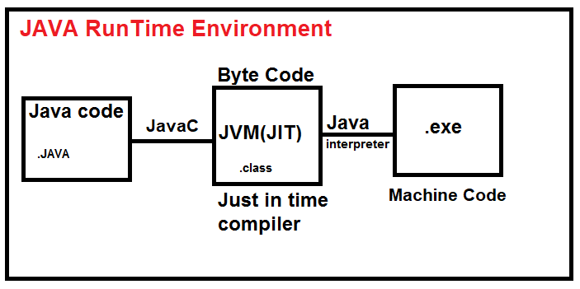
Compilation of Process of JAVA

Slide 7
Java development kit (JDK)

Slide 8
Java development kit (JDK)
JDK stands for Java Development Kit. It's a software development environment specifically designed for creating Java applications. It essentially provides all the tools and resources programmers need to build Java programs from scratch.
JDK includes various tools like a compiler (javac) to convert Java code into bytecode, an archiver (jar) to package application components, a debugger to identify and fix errors, and a documentation generator (Javadoc) to create documentation for your code.

Slide 9
Java Runtime Environment (JRE)

Slide 10
Java Runtime Environment (JRE)
The Java Runtime Environment (JRE) is a software package that provides the essential components needed to run Java applications on your computer. It includes the following components
Java Class Library (JCL): This library contains pre-written code for common functionalities like input/output, networking, and GUI development. Developers can leverage these classes to build their applications without reinventing the wheel.
Java Virtual Machine (JVM): it is also the part of JRE.

Slide 11
Java Virtual Machine (JVM)

Slide 12
Java Virtual Machine (JVM)
The Java Virtual Machine (JVM) is a software program that acts as a runtime environment for executing Java bytecode.
It interprets and executes the bytecode instructions, translating them into machine code understood by the underlying hardware making java application "write once, run anywhere" (WORA).
The JVM manages memory allocation and deallocation for the program, including garbage collection to reclaim unused memory.
The JVM enforces security measures like sandboxing to prevent unauthorized access to system resources.

Slide 13
Variable

Slide 14
Rules of Variable
A variable name is any combination of 1 to 31 alphabets, digits or underscores.
The first character in the variable name must be an alphabet or underscore.
No commas or blanks are allowed within a variable name.
No special symbol other than an underscore (as in gross_sal) can be used in a variable name.
Create a variable name in camel case.
Declare a variable like type variableName;

Slide 15
Data Types

Slide 16
Primitive (value type) Data Types in java
byte 1 byte
short 2 bytes C++
int 4 bytes C++
long 8 bytes C++
float 4 bytes (14.78945616) 6 to 8 digits precise
double 8 bytes C++ (15 digits precise)
boolean 1 bit (true,false/1,0) bool in C++
char 2 bytes (store uni-codes UTF-8/UTF-16/UTF-32) ASCII
String (reference type)

Slide 17
Operators

Slide 18
Arithmetic Operators
Arithmetic operators are given below
(add)+,(subtract) -,(multiply) *, (divide)/ and (modulus) %.
Same as in c++ and other languages.
Explore maths library in java
https://docs.oracle.com/javase/8/docs/api/java/lang/Math.html

Slide 19
Operator Precedence

Slide 20
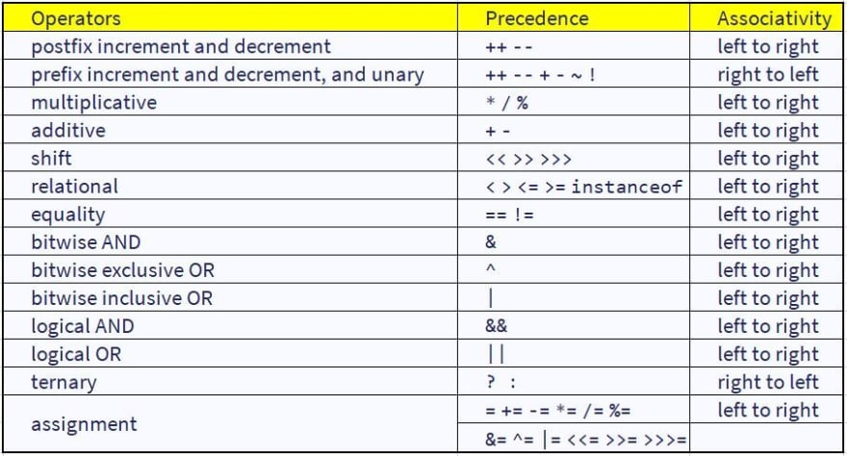

Slide 21
Operator Precedence Example

Slide 22
Operator Precedence Example
int i = 2 * 3 / 4 + 4 / 4 + 8 - 2 + 5 / 8; answer 8
int n = 3 / 2 * 4 + 3 / 8 + 3;
g = big / 2 + big * 4 / big - big + abc / 3 ;
(abc = 2.5, big = 2, assume g to be a float)
4. on = ink * act / 2 + 3 / 2 * act + 2 + tig ;
(ink = 4, act = 1, tig = 3.2, assume on to be an int)
5. s = qui * add / 4 - 6 / 2 + 2 / 3 * 6 / god ;
(qui = 4, add = 2, god = 2, assume s to be an int)
6. s = 1 / 3 * a / 4 - 6 / 2 + 2 / 3 * 6 / g ;
(a = 4, g = 3, assume s to be an int)

Slide 23
Syntax of Main Method

Slide 24
Syntax of Main Method
Import java.lang;
public class Abc{
public static void main(String[] args) {
// Your program code goes here
System.out.println(“hellow World”);
}
}

Slide 25
Syntax of Main Method
public: This keyword specifies that the main method is accessible from anywhere in the program.
static: This keyword indicates that the main method can be called without creating an instance of the class containing it. This is because the main method is typically used to execute the program itself, and object creation might not be necessary.
void: This keyword specifies that the main method does not return any value.
main(String[] args): This is the method signature.
main: This is the name of the method, and it must be named main for the JVM to recognize it as the entry point of the program.
String[] args: This is the parameter list. The args parameter is an array of strings that can be used to pass command-line arguments to the program when it is executed.

