Slide 1
Summer Bootcamp in JAVA Lecture 2
Bilal Arif (Senior Lecturer)
Department of Software Engineering, University of Management and Technology Lahore.

Slide 2
Lecture 2 Overview

Slide 3
Operators

Slide 4
Unary Operators
Unary operators are given below
Pre increment (++), Post increment (++), Pre decrement (--), Post decrement (--)
Not (!), Bitwise inverter (~)
Same as in c++ and other languages.

Slide 5
Binary Operators
Arithmetic Operators
Add(+),subtract(-),multiply(*),divide(/),modulus(%)
Relational Operators
Less than(<), greater than(>),less equal(<=),greater equal(>=),not equal(!=),equal(= =)
Assignment Operators
=, +=, -=, *=, /=,%=, &=, |=, ^=, >>=,<<=
Logical Operators
And(&&), OR(||), Not(!)
Logical Operators
And(&&), OR(||), Not(!)
Shift Operators
Right shift (>>),Left shift(<<)

Slide 6
Ternary Operators
(Exp)? True statement : false statement;
Nested ternary Operators
(Exp) ? (true statement) : ((exp) ? true statement : false statement);

Slide 7
Operator Precedence

Slide 8
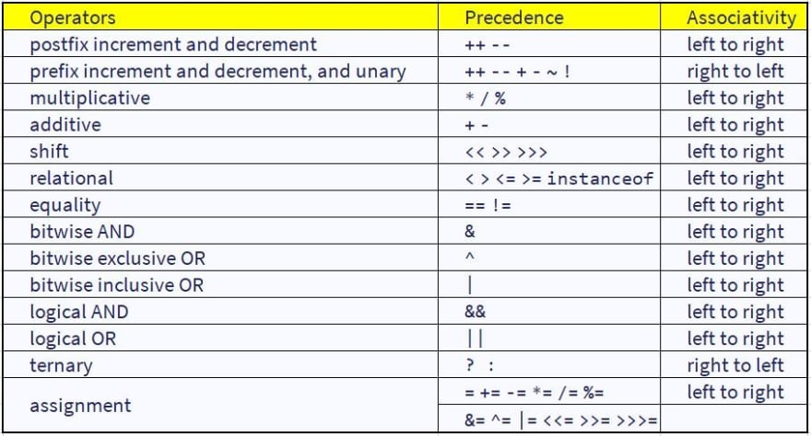

Slide 9
Control Structure in Java

Slide 10
Loops in Java

Slide 11
String in Java

Slide 12
Regular expression in Java

Slide 13
Date Time Library

