Slide 1
Summer Bootcamp in JAVA Lecture 4
Bilal Arif (Senior Lecturer)
Department of Software Engineering, University of Management and Technology Lahore.

Slide 2
Lecture 4 Overview

Slide 3
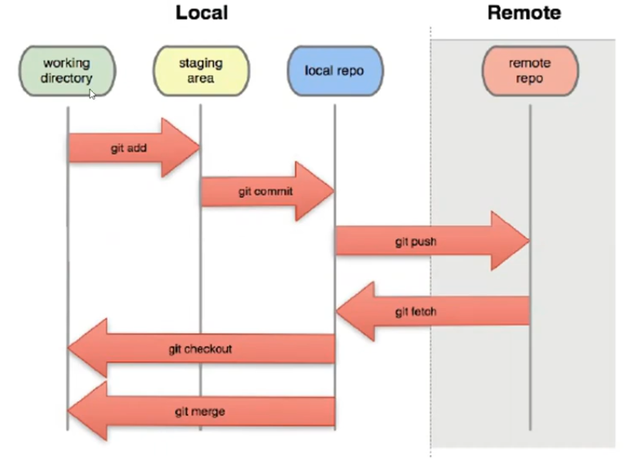

Slide 4
Branching in git
When you create a repository, default branch(master) is created.
A branch is a pointer. It refers to the development tree and you may create many branches.
A commit is a node which has pointer to previous commit. When you make a commit branch pointer starts pointing to new commit node.
Head is a pointer which points to active branch.

Slide 5
Branching Scenarios

Slide 6
GitHub.com

Slide 7
Introduction to GitHub.com
Github is web based git version control repository hosting service.
It also provide many collaboration features like bug tracking, feature request, task management, wikis etc.
Private & public repository
Other such hosting services: GitLab, Bitbucket etc.
You may have your own git server for repository management

Slide 8
Remote Repository
Step1: Clone the repository from Server
Step2: Make local commits, create branches (if required) etc.
Step3: Pull/fetch changes from server, Merge changes with your local changes
Step 4: Push changes to remote repository
Step 5: repeat step 2

Slide 9
