Slide 1
Summer Bootcamp in JAVA Lecture 10
Bilal Arif (Senior Lecturer)
Department of Software Engineering, University of Management and Technology Lahore.

Slide 2
Lecture 10 Overview
Method Overriding
Final keyword
Polymorphism and types of polymorphism
Abstract classes
Interfaces
Project Discussion: Attendance Management System

Slide 3
Method Override

Slide 4
Method Override
When child has the same method as declared in the parent class, it is known as method overriding in Java.
Rules for Java Method Overriding
There must be an IS-A relationship (inheritance).
The method must have the same name as in the parent class
The method must have the same parameter as in the parent class.
The method must have the same return type as in the parent class.

Slide 5
FAQ’s of Method Overriding
Can we override static method?
It is because the static method is associated with the class. We cannot associate the same static method with other class.
Can we override Main method?
No, because main method is also a static method.

Slide 6
Final Keyword
The final keyword in java is used to restrict the user. The java final keyword can be used in many context. Final can be:
variable
method
class

Slide 7
Polymorphism

Slide 8
Polymorphism
Polymorphism in Java is a concept by which we can perform a single action in different ways.
Polymorphism is derived from 2 Greek words: poly and morphs. The word "poly" means many and "morphs" means shapes. So polymorphism means many shapes.
There are two types of polymorphism in Java:
compile-time/Early binding/static polymorphism
Runtime/late binding/ dynamic polymorphism.

Slide 9
Static Polymorphism

Slide 10
Static Polymorphism
Static polymorphism can be implemented through
Method Overloading
Operator Overloading

Slide 11
Dynamic Polymorphism

Slide 12
Dynamic Polymorphism
Getting different behaviors from a method using a variable of same type based on object present in it at execution time is called polymorphism.
Dynamic polymorphism can be implemented through
Inheritance
Method Overriding
What is pure dynamic polymorphism?
A class contain only abstract methods/pure virtual methods. Which can be achieved by abstract classes and interfaces in java.

Slide 13
Abstract class

Slide 14
Abstract Class
Abstraction is a process of hiding the implementation details and showing only functionality to the user.
A class which is declared with the abstract keyword is known as an abstract class in Java. It can have abstract and non-abstract methods.
An abstract class must be declared with an abstract keyword.
It can have abstract and non-abstract methods.
It cannot be instantiated.
It can have constructors and static methods also.
It can have final methods which will force the subclass not to change the body of the method.

Slide 15
Abstract Method

Slide 16
Abstract Method/pure virtual method
A method which is declared as abstract and does not have implementation is known as an abstract method.(no body)

Slide 17
Interfaces

Slide 18
Interfaces in java
The interface in Java is a mechanism to achieve abstraction.
There can be only abstract methods in the Java interface, not method body.
It is used to achieve abstraction and multiple inheritance in Java.
By interface, we can support the functionality of multiple inheritance.
It can be used to achieve loose coupling.

Slide 19
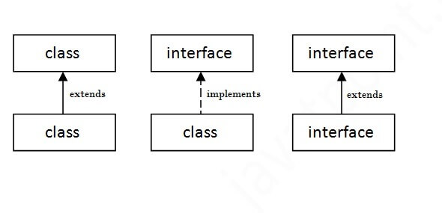
Relationships in java

Slide 20
Attendance Management System Part-2

Slide 21
Attendance Management System part-2
Implementation (front-end)
Implementation (back-end)
Task discussion

