Slide 1
Summer Bootcamp in JAVA Lecture 11
Bilal Arif (Senior Lecturer)
Department of Software Engineering, University of Management and Technology Lahore.

Slide 2
Lecture 11 Overview
Exceptions in java
Exception-handling
Types of Exceptions
Exception Keywords
Exception Scenarios
Custom Exceptions
Project Discussion

Slide 3
Exceptions

Slide 4
Exceptions
Exception is an abnormal condition.
In Java, an exception is an event that disrupts the normal flow of the program. It is an object which is thrown at runtime.

Slide 5
Exception handling
Exception Handling is a mechanism to handle runtime errors such as ClassNotFoundException, IOException, SQLException etc.
The core advantage of exception handling is to maintain the normal flow of the application.

Slide 6
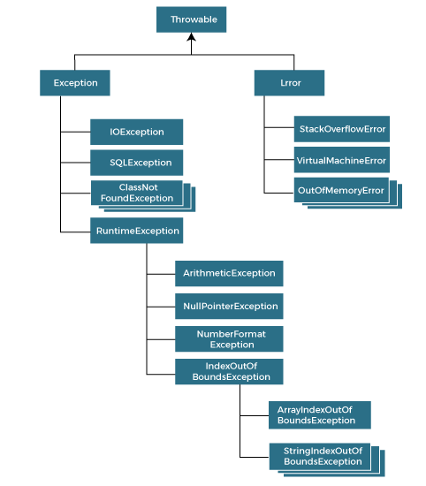

Slide 7
Types of Java Exceptions
There are mainly two types of exceptions: checked and unchecked.
Checked Exception
Unchecked Exception

Slide 8
Checked Exception

Slide 9
Checked Exception
Checked exceptions are checked at compile-time.
IOExceptions
SQLExceptions
ClassNotFoundExceptions
InteruptedExceptions etc.

Slide 10
Un-Checked Exceptions

Slide 11
Un-Checked Exceptions
Unchecked exceptions are not checked at compile-time, but they are checked at runtime.
For example,
ArithmeticExceptions
NullPointerException
ArrayIndexOutOfBoundsException etc.

Slide 12
Exception Keywords

Slide 13
Exception Keywords
Try [where we should place an exception code]
Catch [block is used to handle the exception]
Finally [It is executed whether an exception is handled or not.]
Throw [used to throw an exception]
Throws [It doesn't throw an exception. It is always used with method signature]

Slide 14
Scenarios of Java Exceptions

Slide 15
Project discussion

