Slide 1
Summer Bootcamp in JAVA Lecture 9
Bilal Arif (Senior Lecturer)
Department of Software Engineering, University of Management and Technology Lahore.

Slide 2
Lecture 9 Overview
Inheritance
Types of Inheritance
Discussion on Project Requirements
Class diagram
Assignment 9 tasks

Slide 3
Inheritance

Slide 4
Inheritance
Inheritance is a mechanism in which one object acquires all the properties and behaviors of a parent object. extends keyword use for inheritance.
Why we are using inheritance?
For Method Overriding
For Code Reusability.
Sub Class/Child Class: Subclass is a class which inherits the other class. It is also called a derived class, extended class, or child class.
Super Class/Parent Class: Superclass is the class from where a subclass inherits the features. It is also called a base class or a parent class.

Slide 5
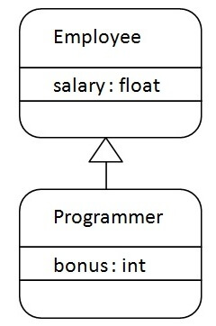
Inheritance class diagram

Slide 6
Types Inheritance

Slide 7
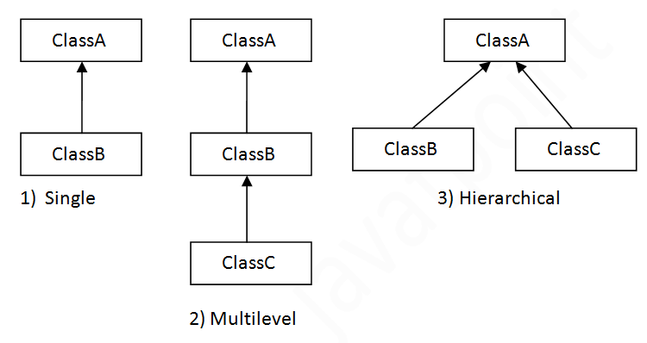
Types of inheritance-1

Slide 8
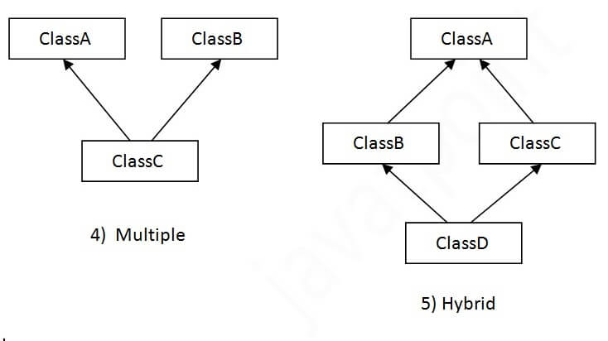
Types of inheritance-2

Slide 9
Attendance Management System Part-1

Slide 10
Attendance Management System part-1
Understand Requirements of the project
Ready the design of the project (UML class diagram)
Implementation (front-end)
Implementation (back-end)

