Slide 1
Summer Bootcamp in JAVA Lecture 13
Bilal Arif (Senior Lecturer)
Department of Software Engineering, University of Management and Technology Lahore.

Slide 2
Lecture 13 Overview
Introduction to database
Types of Databases
SQL commands syntax
Apache xampp MYSQL server download and installation
Database Architectures
JDBC connectivity using java

Slide 3
What is Database?

Slide 4
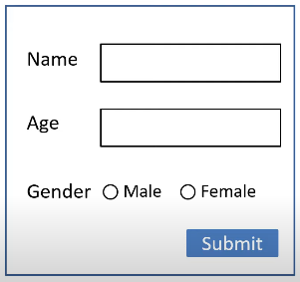
What is database?
A database is a collection of data stored in a format, so that it can be easily accessed and managed.
There are many databases available like MySQL, Sybase, Oracle, MongoDB, PostgreSQL, MS SQL Server, etc.
Structured Query Language (SQL) is used to operate on the data stored in a database.
Name | Age | Gender
Ali adnan | 21 | Male
Muneeba | 22 | Female
Asif | 21 | Male
Ahmad | 20 | Male

Slide 5
What is DBMS?

Slide 6
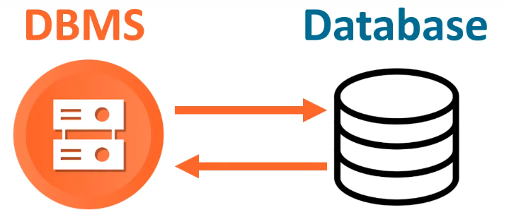
What is DBMS?
DBMS are software systems used to store, retrieve, and run queries (user-requests) on data. A DBMS serves as an interface between an end-user and a database, allowing users to create, read, update, and delete data in the database.

Slide 7
How DBMS works?
There are many DBMS software available like MySQL, Oracle, MongoDB, PostgreSQL, MS SQL Server, etc.

Slide 8
What is RDBMS?

Slide 9
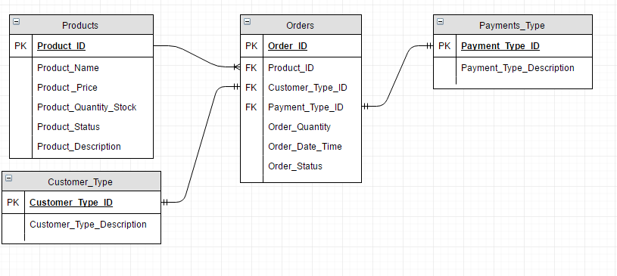
What is RDBMS?
A relational database management system (RDBMS) is a program used to create, update, and manage relational databases. Some of the most well-known RDBMSs include MySQL, Oracle, PostgreSQL, Microsoft SQL Server etc.

Slide 10
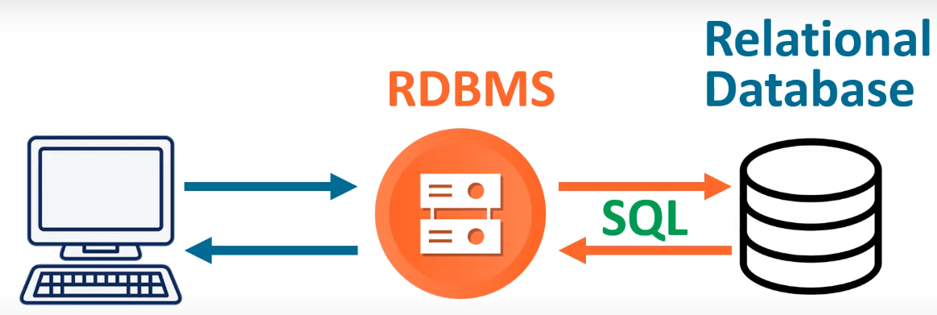
How RDBMS works?

Slide 11
Types of Database

Slide 12
Types of Database
There are two different types of database Relational Database and noSQL database.

Slide 13
NoSQL database
Document database: NoSQL database store data as semi-structured documents, such as JSON or XML, and can be queried using document-oriented query languages.
Key-value stores: These databases store data as key-value pairs, and are optimized for simple and fast read/write operations.
Column-family stores: These databases store data as column families, which are sets of columns that are treated as a single entity.
Graph databases: These databases store data as nodes and edges, and are designed to handle complex relationships between data.
e.g: MongoDB, Redis, firebase, Cassandra, CouchDB, Cloudant etc.

Slide 14
MySQL (Relational Database)

Slide 15
MySQL Server
It is a open-source, RDBMS software and sql server.
Cross Plat-from
Support multiple programming languages(php, nodeJS, python, C#, java etc.)
Mysql server is fast, reliable, scalable and easy to use.
Mysql server most used in client/server or embedded systems.
Facebook, twitter, google, youtube, Wikipedia using mysql server.

Slide 16
MySQL download & installation

Slide 17
SQL Queries/SQL Commands

Slide 18
How to create a SQL table?
To create database SQL table identity the following things table name, column names, column datatypes.
Name | Age | Gender
Ali adnan | 21 | Male
Muneeba | 22 | Female
Asif | 21 | Male
Ahmad | 20 | Male

Slide 19
Create table SQL command
CREATE TABLE table_name(
column1 datatypes,
column2 datatypes,
column3 datatypes,
….
);

Slide 20
String Datatypes of SQL
CHAR(SIZE) 0-255
VARCHAR(SIZE) 0-65535
BINARY
VARBINARY
TINYTEXT 255 CHARACTERS
TEXT(SIZE) 65535 bytes
MEDIUMTEXT 16,777,215 CHARACTERS
LONGTEXT 4,294,967,295 characters
TINYBLOB 255 BYTES
BLOB(SIZE) 65535 BYTES
MEDIUMBLOB 16.777,215 BYTES
LONGBLOB 4,294,967,295 BYTES
ENUM(VAL1,VAL2,VAL3)
SET(VAL1,VAL2,VAL3)

Slide 21
Numeric Datatypes of SQL
BIT 1bytes
TINYINT 1bytes
INT 4 bytes
INTERGER 4bytes
SMALLINT 2bytes
MEDIUMINT 3bytes
BIGINT 8bytes
BOOL 1bit
BOOLEAN 1 bit
FLOAT(P) 4 bytes
DOUBLE(SIZE,D) 8 bytes
DECIMAL(SIZE,D) size = 60 digits, D = 30 digits
DEC(SIZE,D) size = 60 digits, D = 30 digits

Slide 22
Date & Time Datatypes of SQL
DATE ‘1000-01-01’ TO ‘9999-12-31’
DATETIME YYYY-MM-DD hh:mm:ss
TIMESTAMP YYYY-MM-DD hh:mm:ss
TIME hh:mm:ss
YEAR Four digit format: 1992

Slide 23
Create a person table

Slide 24
Insert SQL command

Slide 25
List of constrains

Slide 26
List of constrains
Not NULL
Unique
Default
Check
Foreign key
Primary key
Note: Female gender is missing in 2nd row and age must greater then 18
Name | Age | Gender | DOB
Ali adnan | 17 | Male | 1992-11-09
Muneeba | 22 |  | 1998-03-14
Asif | 21 | Male | 1996-04-10
Ahmad | 20 | Male | 1994-07-18

Slide 27
Create table SQL command
CREATE TABLE table_name(
column1 datatypes constrain,
column2 datatypes constrain,
column3 datatypes constrain,
….
);

Slide 28
Create person table with constrains

Slide 29
More SQL Queries

Slide 30
JDBC

Slide 31
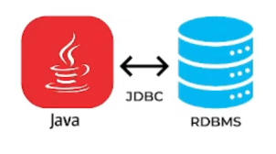
JDBC
JDBC stands for Java database connectivity – a powerful API that allows java program to access and manipulate data stored in a wide variety of databases.
JDBC api’s defines how a client can connect to a database sent SQL queries and retrieve, manipulate the results.
JDBC consist of set of interface and classes written in java.
JDBC provides a platform independence, security and ease of use for java developers who need to access database.

Slide 32
JDBC
Therefore using JDBC we can do the following (and more):-
Connect to a database
Execute SQL statements to query the database
Generate query results
Perform updates, inserts and deletions
Execute Stored Procedure

Slide 33
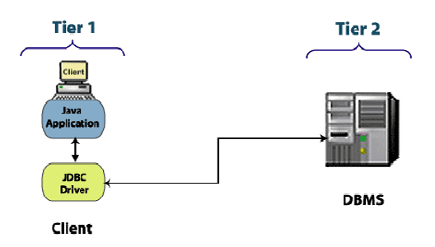
JDBC 2-tier model

Slide 34
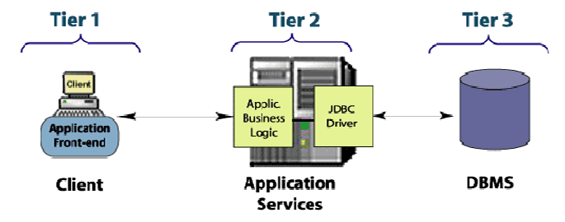
JDBC 3-tier model

