Slide 1
Summer Bootcamp in JAVA Lecture 16
Bilal Arif (Senior Lecturer)
Department of Software Engineering, University of Management and Technology Lahore.

Slide 2
Generics in Java

Slide 3
Generics in Java
Generics types allow you to define a class, interface or method with placeholders (type parameters) for the data types they will work with.
public class Mutiply <T>{
T num;
}

Slide 4
Lambda Expression in Java

Slide 5
Lambda Expression in Java
Lambda is a anonymous function no name, no access modifier, no return type.
()->{ }
It reduce the line of code
If lambda expression contain only one line for body brackets required
()->System.out.println(“hello”);
Arguments type not required in lambda expression.
(a,b)-> System.out.print(a+b);

Slide 6
Lambda Expression in Java
If the interface contains only one method then it is functional interface.
Ex: Runnable, callable, Compareable etc.
Lambda expression is used to implement functional interface in very simple and short manner.

Slide 7
Anonymous Classes in Java

Slide 8
Inner Classes in Java

Slide 9
What is Data Structure?

Slide 10
What is Data Structure?
Organizing and storing data to perform operations efficiently. It defines the format, how to organize, and manipulate the data.
1D, 2D, 3D arrays [add, delete, update, sort etc.]
Linked lists [single LL, circular SLL, Double LL Double circular LL]
Stack and Queue [Array based or LL based], Priority queue
Trees[Binary tree, Binary Search Tree, AVL balanced tree, Heap tree, Min heap, Max heap, RedBlack Tree, B+ Tree etc.]
Hashing[Hash Table]
Graphs [directed and non directed graphs]

Slide 11
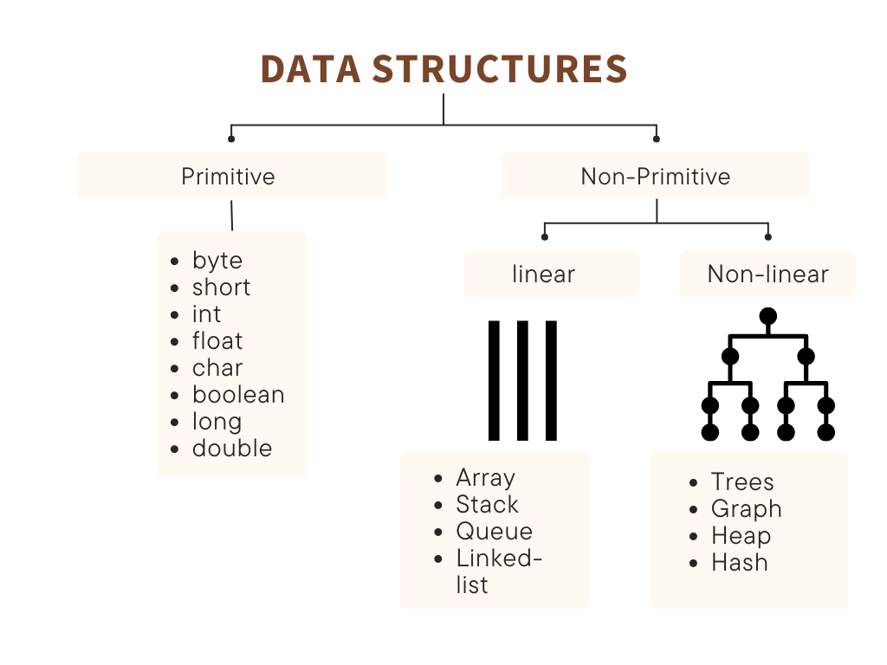
Data Structure hierarchy

Slide 12
Collection Framework API in Java

Slide 13
Collections in java
Java collection framework is the set of collection types that are included as part of core Java. It provides the APIs or methods that you can use directly to operate on the data structures such as Arrays, Linked Lists, stacks, queues, sets, and maps. If you master Java collections, it will save you tons of time and help to solve complex problems.

Slide 14
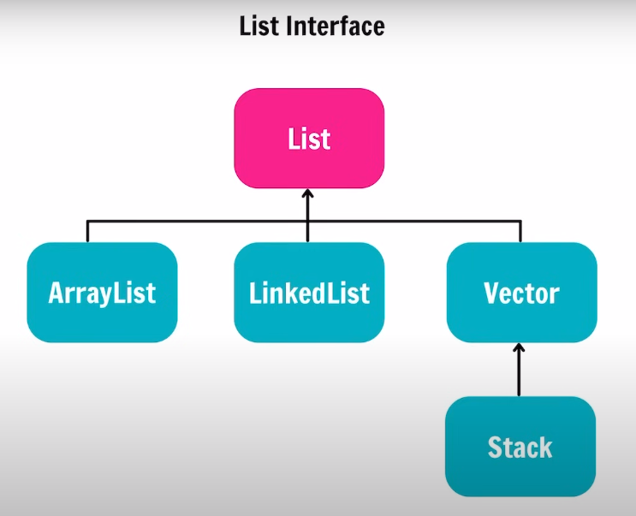
Collections in Java -1

Slide 15
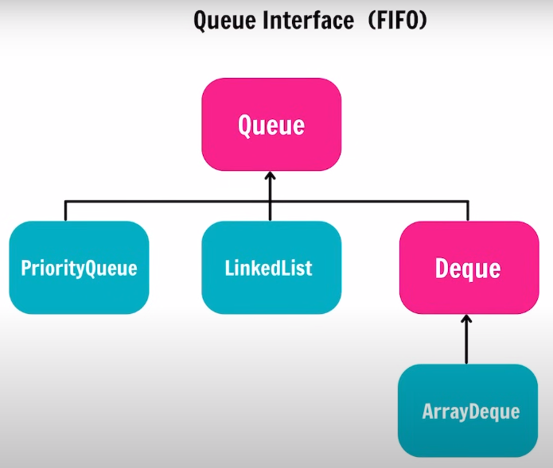
Collections in Java -2

Slide 16
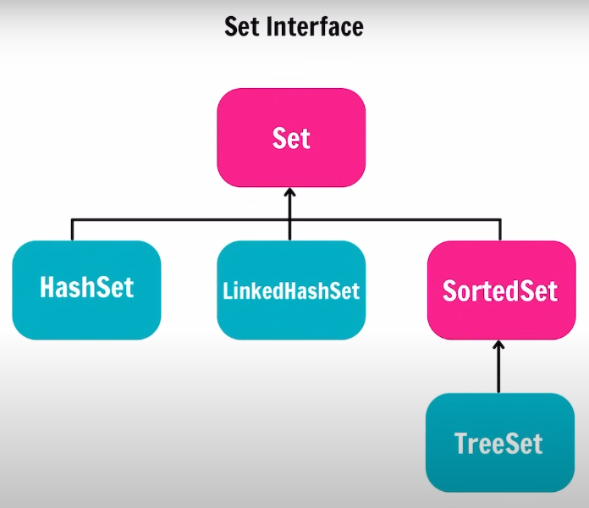
Collections in Java -3

Slide 17
Collections in Java -4

