Slide 1
Summer Bootcamp in JAVA Lecture 17
Bilal Arif (Senior Lecturer)
Department of Software Engineering, University of Management and Technology Lahore.

Slide 2
Lecture Overview
Complete Roadmap of data structure and algorithm (DSA)
Time & space complexity complete discussion
How to create my own data structure using java?
Project Discussion: Word dictionary using collections in java

Slide 3
Compete Road-Map of Data Structure and Algorithm

Slide 4
Road-Map of DSA-1
What is reference Object and how to use reference objects?
Reference object memory Management
Linear data structure static and dynamic array, Linked List (SLL,SCLL,DLL,DCLL), Stack, Queue, Priority Queue, Circular Queue along with time and space complexity
Recursion along with time and space complexity
Sorting Algorithms (insertion sort, bubble sort, selection sort, merge sort, quick sort, heap sort, counting sort, bucket sort etc.) along with time and space complexity

Slide 5
Road-Map of DSA-2
Searching Algorithms (linear search, binary search) along with time and space complexity
Trees (Binary tree, Binary search tree, AVL tree, B+ tree, redblack tree, Heap, min Heap, max Heap) along with time and space complexity
Graphs (directed graphs, undirected graphs, adjacency matric, adjacency list, breath first searching, depth first searching, minimum spinning trees, Topological sort, shortest path algorithms)
Dynamic Programming(memorization and tabulation approaches)
Back Tracking using recursion.

Slide 6
Road-Map of DSA-3
Generics
Collections
Lambda Expression

Slide 7
Time Complexity

Slide 8
Time Complexity
The amount of computer time it takes to run an algorithm.
Time Complexity is basically the relation between input size and CPU(Operations).

Slide 9
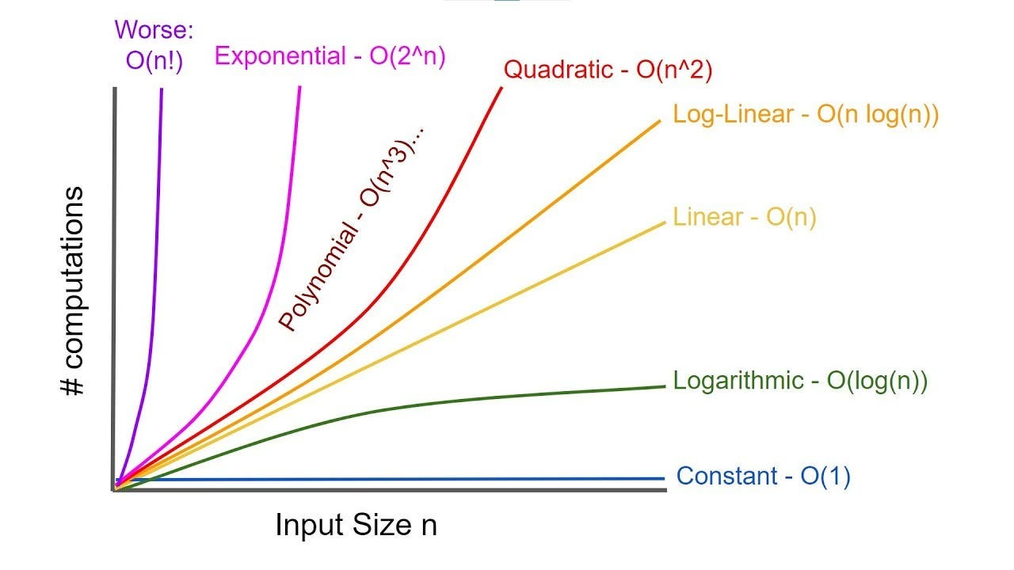

Slide 10
Space Complexity

Slide 11
Space Complexity
The amount of memory space required to solve an instance of the computational problem

Slide 12
Implement my own Linked List Data Structure using Java

Slide 13
Project: Word Dictionary using Data Structure / Collections

