Slide 1
Summer Bootcamp in JAVA Lecture 18
Bilal Arif (Senior Lecturer)
Department of Software Engineering, University of Management and Technology Lahore.

Slide 2
Lecture Overview
What is CPU?
What are the Cores in CPU?
What is a process? and what is Multi-processing?
What is a thread? and What is Multi-threading?
How to create multi-threading in java?
Life cycle of thread
What is Synchronization?
Producer-Consumer Problem

Slide 3
What is CPU?

Slide 4
CPU
The CPU, often referred to as the brain of the computer.
It is responsible to executing instructions from program.
It performs basic arithmetic, logic, control and input/output operation.
e.g. Intel core i-7, AMD Ryzen-7 etc.

Slide 5
What is Core?

Slide 6
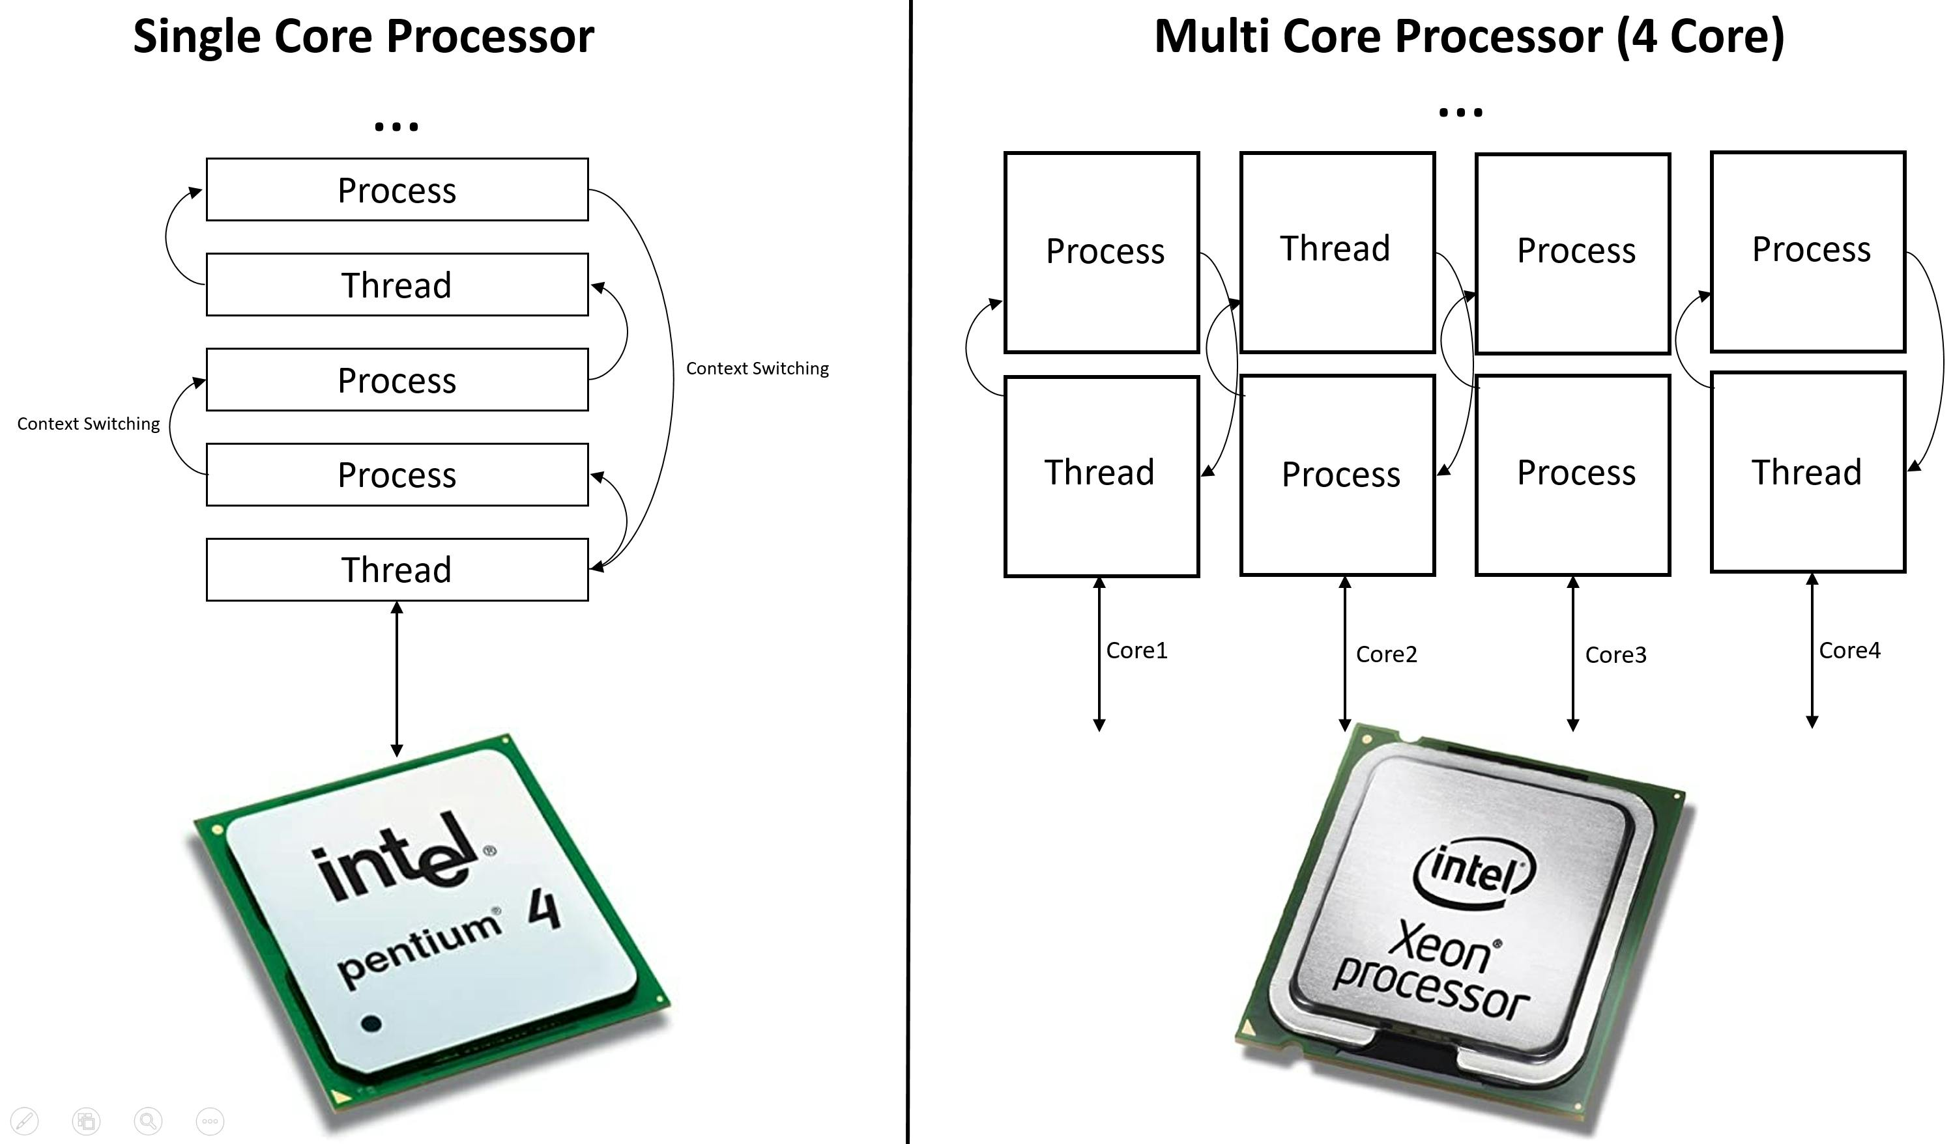
Core
A core is an individual processing unit within a CPU.
Modern CPU’s can have multiple cores, allowing them to multiple tasks simultaneously.

Slide 7
What is a Process?

Slide 8
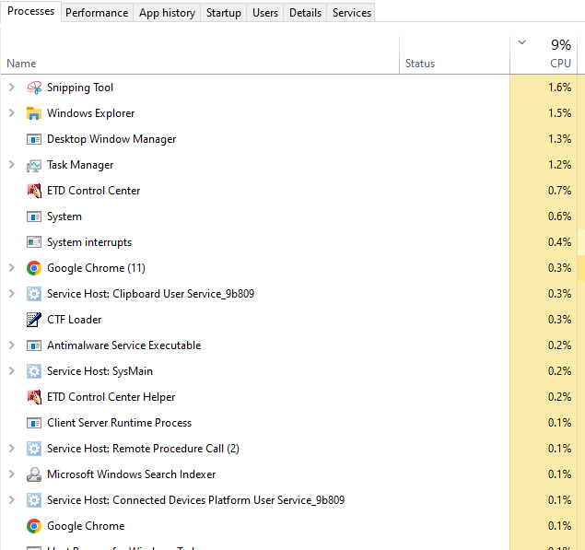
Process
A process is an instance of a program that is being executed.
When a program runs the operating system creates a process to manage its execution.

Slide 9
What is Multi-Processing?

Slide 10
Multi-Processing
It allows an operating system to run multiple processes simultaneously.
On single-core CPU, this is done through time sharing, rapid switching between tasks.
In multi-core CPU executes processes parallelly. OS Scheduler balances the (resources) load to ensuring efficient and responsive system performance.
e.g: we a listening music on vlc, working on browser and Ms office and also download some files simultaneously.

Slide 11
What is a Thread?

Slide 12
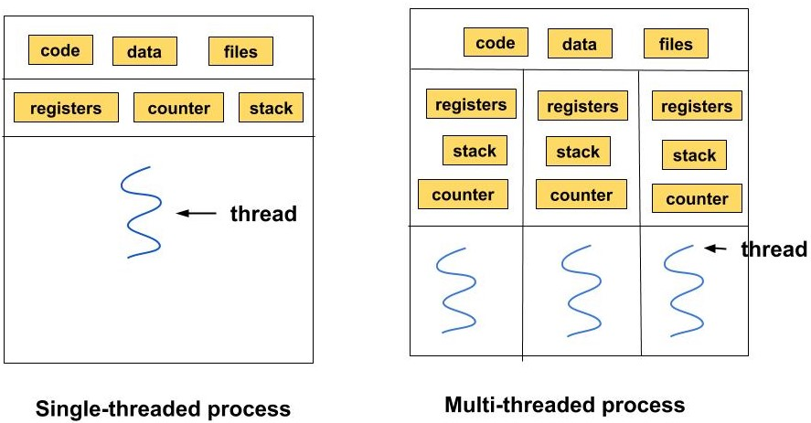
Thread
It is a smallest unit of execution within a process.
A process can have multiple threads.
Which share the same resources but can run independently.

Slide 13
What is Multi-Threading?

Slide 14
Multi-Threading
It is a process of executing multiple threads simultaneously.
It refers to the ability to execute multiple threads within a single process concurrently.
A thread is a lightweight sub-process, the smallest unit of processing.
e.g: A web browser can use multithreading by have separate threads for loading the page, and managing user inputs.
Note that multi-threading enhances the efficiency of multitasking by breaking down individual tasks into smaller threads (sub-tasks) making better use of the CPU’s capabilities.
Multi-threading in single-core vs multiple-core CPU.

Slide 15
Single-core vs Multiple-core CPU.
In single core CPU both threads and processes are manages by OS scheduler through time slicing and context switching of simultaneously execution.
In Multiple core CPU both threads and processes are run parallel on different core with the OS scheduler distributing tasks across the core to optimize the performance.

Slide 16
Multi-Threading in Java

Slide 17
Multi-Threading in java
Java multi-thread capabilities are a part of java.lang package, ,making it easy to implement concurrent execution.
In java JVM distributes thread across multiple cores allowing parallel execution of threads.
Java supports multi-threading through
java.lang.Thread class
Java.lang.Runnable interface
Note that: when java program starts one thread begins running immediately, that is main thread. This thread is responsible for executing the main method of a program.

Slide 18
Life cycle of Thread

Slide 19
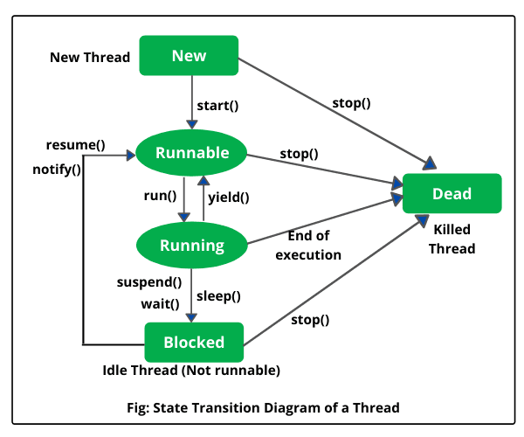

Slide 20
Life cycle of Thread
New: When thread is create but not started yet.
Runnable: After method is called the thread become runnable and waiting to CPU time.
Running: When thread is executing.
Block/Waiting: When it is waiting for I/O operation or resources or action for another thread.
Terminated: When is dead or finish.

Slide 21
Thread Class

Slide 22
Which is a better way to implement Thread?

Slide 23
Synchronization

Slide 24
Producer-Consumer Problem

